Slide 1
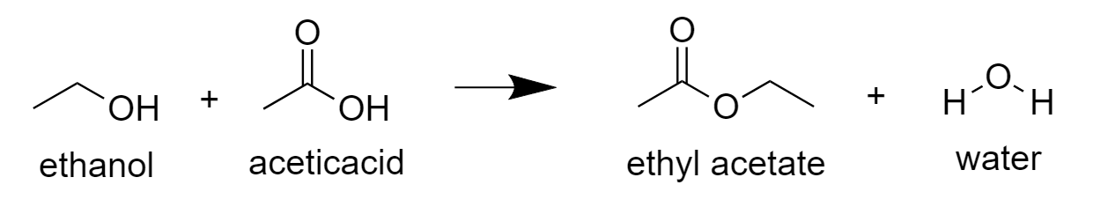
Problem Statement: Model an ethyl acetate production plant in Aspen Plus with the following design specifications and parameters.
Design Specification: Produce >85 mol% pure ethyl acetate.
Parameters:
Reaction:
C₂H₅OH + CH₃COOH → C₄H₈O₂ + H₂O
Feed:
    Pure Ethanol at 200 kg/min.
    Pure Acetic Acid at 261 kg/min.
    Ambient temperature and atmospheric pressure.

Slide 2
Vapor draw off
Ethyl acetate rich distillate
Ethanol
Ethyl acetate and water
Distillation Column
Reactor
Acetic Acid
Water-rich bottoms

